Slide 1
Essentials of Hispanic Marketing: Media Landscape

Slide 2
Understanding Hispanic Consumers on Three Levels
1
Demographics & Economic Opportunity
2
Cultural Insights for Best-in-Class Marketing
3
Media Landscape

Slide 3

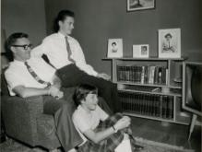
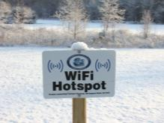
Today’s Three Sections
In Language ≈
In Culture
Media Landscape:
Traditional Media
Media Landscape:
New Media

Slide 4

In Language ≈ In Culture
Image Source: michael davis-burchat. https://www.flickr.com/photos/curious_e/

Slide 5

We Saw the Importance of Spanish Language Earlier…
74%
of Hispanics
speak Spanish
at home
Percent who Speak Spanish at Home
…although there are still dialects and nuances by country and region
Source: American Community Survey (2012)

Slide 6
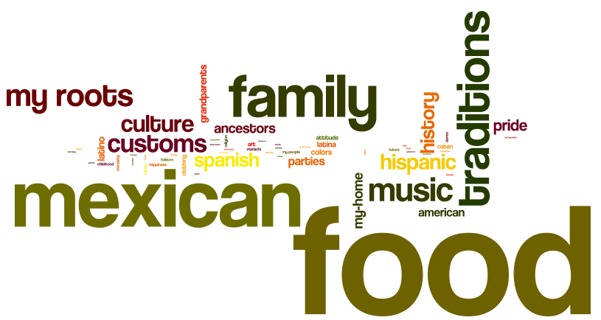
…But There is Far More to Culture than Just Language
We asked the VozLatinum community:
“When I think of my cultural heritage I think of...”
Source: Latinum Cultural Influencer Study (2013)

Slide 7
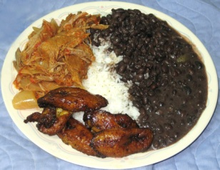

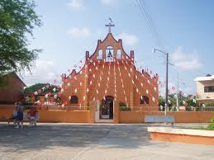
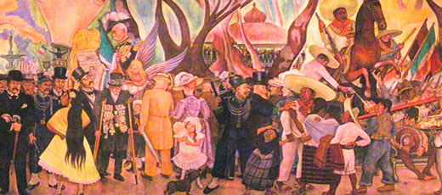

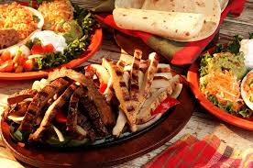
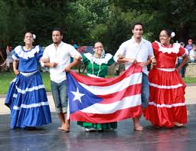

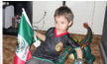
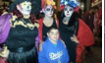
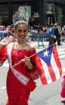
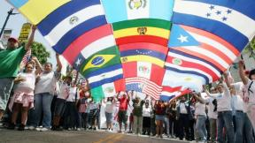
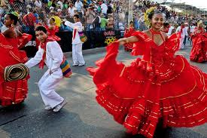

Language Is a Lens to See Culture – It Offers a Clearer and Richer Understanding
Language
7

Slide 8
Hispanics Are Much More Emotionally Engaged With In Culture: In Language Advertisements
Single-Language Ads Following Single-Language TV Programming
 | Context-Spanish Ad-English | Context-Spanish Ad-Spanish | Context-English Ad-English
Effectiveness | 6.5 | 6.5 | 6.2
Attention | 6.7 | 5.8 | 6.2
Emotional Engagement | 6.4 | 7.1 | 6.4
Memory Activation | 5.8 | 5.7 | 6.0
Source: The Bilingual Brain (2014). Nielsen, Univision, Starcom

Slide 9

This Engagement Translates Into Better Advertising Results
60% better advertising recall for Bilingual Hispanics¹
Ads organically created for Hispanics were 3x more effective than those “dubbed” into Spanish²
Source:
¹http://www.awool.com/hmw/052200.html
²http://www.comscore.com/ita/Public-Relations/Blog/Advertising-Strategies-for-Targeting-U.S.-Hispanics
Notes:
9

Slide 10

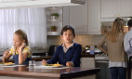








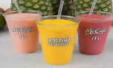

Bicultural Hispanics Are More Likely to Prefer Spanish-Language Versions of Advertisements
VozLatinum Paired English / Spanish Ad Preference Testing (2014)
Bicultural Hispanics
62%
Preferred the
Spanish language
version of the ad
Source: VozLatinum Language Copy Testing (Feb & May 2014)

Slide 11
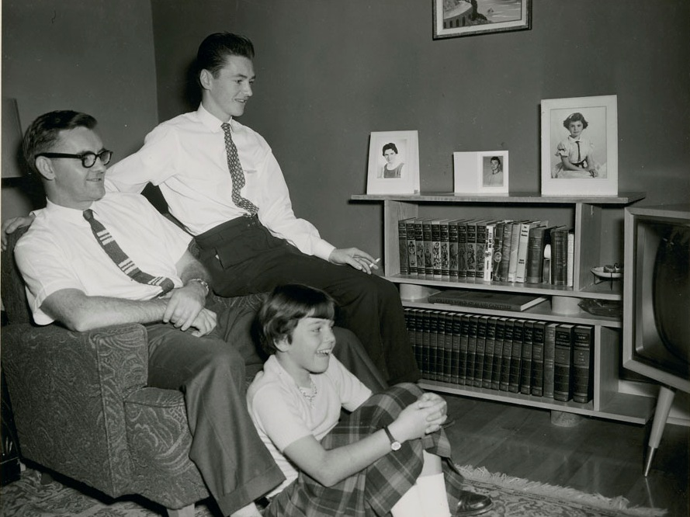
Media Landscape:
Traditional Media
Image Source: BiblioArchives / LibraryArchives. https://www.flickr.com/photos/lac-bac/

Slide 12
The Media Landscape
TV
Radio
Print
Traditional Media
Digital
Social
Mobile
New Media

Slide 13
Television Remains Foundationally Important
Amount of Time Spent Watching TV Per Week (2012)
Hispanic
Non-Hispanic
17
hours
20
hours
per week
per week
Language Distribution of TV Watching by Acculturation (2014)
9%
17%
Accult-urated
Bicultural
Unaccult-
urated
Spanish
Language
45%
91%
55%
83%
English
Language
Source: American Time Use Survey (2013). Simmons NHCS (Winter 2014)

Slide 14
English- and Spanish-Language Audiences Look Very Different
Average Audience Share by Network Type (2012)
9% of the audience of English language broadcasts are Hispanics
English Broadcast
Spanish language viewers are, on average, less acculturated
Spanish Broadcast
Non-Hispanic
Hispanic: English Only
Hispanic: English Mostly
Hispanic: Both Equal
Hispanic: Spanish Mostly
Hispanic: Spanish Only
Source: The Nielsen Company; Latinum Network Analysis

Slide 15
To Active the Total Market, Advertise on English and Spanish Language Television
Total Market Campaign Brief
Impressions Goals: Reach 10% of all six segments
Non-Hispanic
Hispanic: English Only
Hispanic: English Mostly
Hispanic: Both Equal
Hispanic: Spanish Mostly
Hispanic: Spanish Only
Three Case Scenarios
Assumes buying “mean performing programs” (units=$000s)
 |  | From the “Left”: Unoptimized English | Optimized: Integrated: English-Spanish | From the “Right”: Unoptimized Spanish
TV Buys | Spanish | - | $36 (15.7%) | $15,590
 | English | $568 | $195 (84.3%) | -
 | Total | $568 | $231 | $15,590
2010 vs. 2012: Optimal Total Market Spanish-language spend has increased to 15.7% from 14.2% in 2010
Source: The Nielsen Company; Latinum Network Analysis
Note: This is for the population 18-49 only

Slide 16

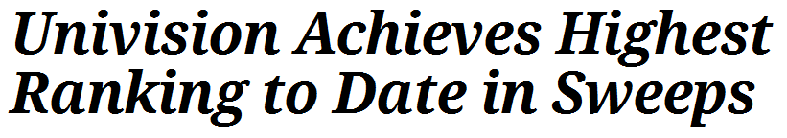
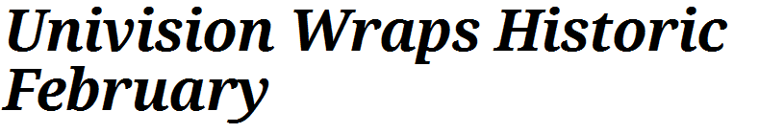
Univision is the Biggest Player for TV
Top Broadcast Networks for Hispanics: Hispanic HH Share Live +7 (2014)
Feb. 2014
Feb. 2013
Strength with Hispanic
Competing with the “Big 4” networks
Source: Nielsen (nielsen.com) based on Hispanic prime-time viewership from 7 p.m. to 11 p.m., Monday through Sunday (4/28/2014-5/25/2014). Strict daypart. Rating is % of Hispanic TV households; share is % of those households with TV sets in use and watching the network. P 2+ counts total Hispanic viewing persons in thousands tuned in to the network. Viewing estimates include 7 days of timeshifted viewing. Percent of households is the rating. Share is percent of TV sets in use.

Slide 17
Radio Remains an Important Media Platform
Average Time Spent Listening to the Radio Per Week (2012)
Hispanic
Non-Hispanic
14
hours
14
hours
per week
per week
Hispanics and non-Hispanics listen to the same amount of radio per week
Source: “Why Radio Fact Sheet.“ Radio Advertising Bureau (2014)

Slide 18
Spanish-Language Stations Are Favorites on Hispanic Radio
Top Radio Formats by Hispanic Audience Share (AHQ 12+)
Radio Format | Share
Mexican Regional | 19%
Spanish Contemporary + Spanish Hot Adult Contemporary | 11%
Pop CHR | 10%
Rhythmic CHR | 8%
Adult Contemporary + Soft Adult Contemporary | 6%
Spanish Adult Hits | 6%
Hot Adult Contemporary | 4%
Country + New Country | 4%
Classic Hits | 4%
News/Talk/Information + Talk/Personality | 3%
Spanish Tropical | 3%
Classic Rock | 2%
Spanish News/Talk | 2%
Spanish Variety | 1%
Spanish Religious | 1%
Tejano | 1%
Spanish Sports | 0.3%
~50%
Of audience share for Hispanic radio listeners 12+ is from Spanish language radio
Source: “Hispanic Radio Today 2013.“ Arbitron (2013)

Slide 19
Local Stations: Local Activation
National Top Stations for Hispanics (both languages)
Notable Spanish Language Stations in Top 3 Markets
Station Name | Station Type | Weekly Cume Persons
KIIS-FM Los Angeles | Pop contemporary hit radio | 2,060,600
KAMP-FM Los Angeles | Pop contemporary hit radio | 1,786,900
KLVE-FM Los Angeles | Spanish contemporary | 1,784,900
WSKQ-FM New York | Spanish tropical | 1,720,600
KPWR-FM Los Angeles | Rhythmic contemporary hit radio | 1,691,500
KBIG-FM Los Angeles | Hot adult contemporary | 1,648,200
KSCA-FM Los Angeles | Mexican regional | 1,525,600
KLAX-FM Los Angeles | Mexican regional | 1,476,400
WXNY-FM New York | Spanish contemporary | 1,409,000
KOST-FM Los Angeles | Adult contemporary | 1,401,800
Los Angeles
KLVE-FM Los Angeles | 7
KSCA-FM Los Angeles | 8
KLAX-FM Los Angeles | 15
New York
WSKQ-FM New York | 4
WXNY-FM New York | 9
Miami
WAMR-FM Miami | 2
WXDJ-FM Miami | 6
WAQI-AM Miami | 10
Overall Total Market Rank (6+)
Overall Total Market Rank (6+)
Overall Total Market Rank (6+)
…and more
Source: Nielsen Audio Fall 2013 (nielsen.com/audio), persons 12+, Monday through Sunday, 6 a.m. to midnight. Local markets Nielsen Topline Ratings (2014)

Slide 20
Hispanics of All Acculturation Levels Read Magazines
Read / Looked at a Magazine in the Last 6 Months (2014)
Hispanic
Non-Hispanic
74%
85%
80%
Acculturated
Total Mag.
Penetration
75%
Bicultural
Total Mag.
Spanish-language magazine use is centered around Bicultural and Unacculturated Hispanics
Penetration
67%
Unacculturated
Total Mag.
Penetration
Source: Simmons NHCS (Winter 2014)

Slide 21










Top Magazines Are a Mix of Spanish and English
Magazine | Hispanic 2014 Penetration (last 6 months)
Smartsource | 36%
Parade Magazine | 28%
People | 16%
Vanidades | 15%
National Geographic | 14%
People En Espanol | 14%
USA Weekend | 13%
Tv Y Novelas | 13%
Time | 13%
Better Homes And Gardens | 13%
Source: Simmons NHCS Winter 2014

Slide 22







Spanish-Language Magazines Present More Specific Targeting Opportunities for Less Acculturated Hispanics
Magazine | Ad Revenue 2013 (in millions)
People en Español | $85
Vanidades | $41
Latina | $36
Ser Padres | $25
TV y Novelas | $23
Siempre Mujer | $18
Cosmopolitan for Latinas | $15
Cosmopolitan en Español | $10
Ser Padres Espera (formerly Espera) | $6
TV Notas | $4
Total | $284
Female, less acculturated
Cuban, female
Bicultural, female
Unacculturated, female
Source: Source: Measured magazine ad spending from HispanicMagazineMonitor, a service of Media Economics Group. Figures exclude internet advertising and circulation revenue

Slide 23

Media Landscape:
New Media
Image Source: woodleywonderworks. https://www.flickr.com/photos/wwworks//

Slide 24
The Media Landscape
TV
Radio
Print
Traditional Media
Digital
Digital
Social
Social
Mobile
Mobile
New Media
-
-

Slide 25
Youth and Improved Economics Narrow the Online Gap
Online Penetration Rate
“Do you use internet or online computer services?"
NH-Asian
NH-White
NH-Af-Am
Hispanic
Source: Simmons NHCS (Winter 2008-2014)

Slide 26
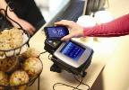





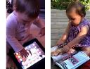












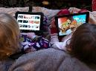

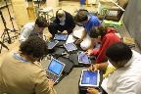





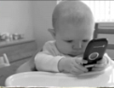
…But “Digital Natives” are Wired from the Beginning, Including Younger Millennials
58% of children 2-5 know how to play a basic computer game
50% of children 2-5 in the U.S. are multicultural
Source: Mashable, May 2012 and The Future Journalism Project, January 2011

Slide 27
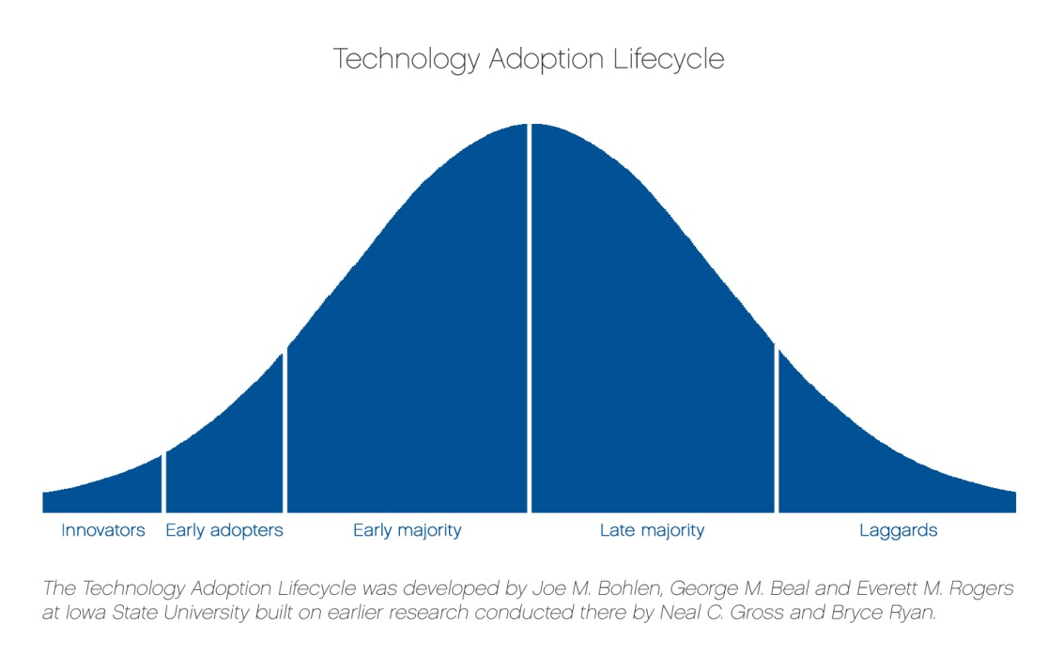




Hispanics and African-Americans Leapfrogging: From Laggards to Pioneers
Technology Leapfrogging: Process in which a population adopts a new technological innovation without ever having adopted the “preceding” technology
Technology Adoption Lifecycle
2020
1980
Computer
Mobile
Pioneers
Early Adopters
Early Majority
Late Majority
Laggards
Source: Mobile Leapfrogging and Digital Device Policy, April 2013

Slide 28
Acculturation and Age Are Key Drivers of Smartphone Adoption
2014 Hispanic Penetration of Digital Devices
Acculturation:
Age:
Hispanic millennials are much more likely than Hispanic non-millennials to own a smartphone
Source: Simmons NHCS (Winter 2014)

Slide 29
Hispanics Have Strong Social Media Across the Acculturation Spectrum
Likelihood of Being a Social Media User (2014)
Hispanic
Non-Hispanic
80%
79%
82%
Acculturated
Driven by:
Favorable demographics
82%
Bicultural
Allows for individual cultural expression
74%
Unacculturated
Source: Simmons NHCS (Winter 2014)

Slide 30




Hispanics Are Near Parity For Many Social Media Platforms
Social Media Platform Use Last 30 Days (2014)
Hispanic
Non-Hispanic
55%
58%
Performs strongly across all acculturation levels
8%
9%
Penetration strongest with bicultural Hispanics
8%
13%
Perform far better with acculturated Hispanics
3%
10%
Source: Simmons NHCS (Winter 2014)

Slide 31

Social Media is a Cultural Experience for Hispanics
Image Source: greyweed “SMM-Jigsaw-Banner” https://www.flickr.com/photos/21986855@N07/
Hispanics share twice as often as non-Hispanics, and those who do share share 5x more…
…and the topic they are most likely to share about (relative to non-Hispanics): Culture and Religion
Source: ShareThis: Online Sharing Behaviors of Hispanic Consumers 2014

Slide 32
Hispanics and Other Multicultural Consumers Have Leapfrogged to Mobile Devices
2014 Penetration of Digital Devices
Computer
Smartphone
Tablet
78%
61%
24%
Hispanic
-10%
+3%
-3%
-Relative to NH-White
83%
65%
29%
NH-Af-Am
-6%
+7%
+2%
-Relative to NH-White
88%
58%
27%
NH-White
Source: Simmons NHCS (Winter 2014). Non-Hispanic Asian datapoints: computer 97%, smartphone 79%, tablet 39%

Slide 33



Hispanic Mobile Users are “Mobile Savvy”
Smartphone Users: App Use in Last 30 Days (2014)
Hispanic
Non-Hispanic
62%
58%
Top App Types:
58%
Social Media
Mobile activity fills social and entertainment needs
31%
Games
31%
Messaging
Source: Simmons NHCS (Winter 2014). VozLatinum: Understanding Hispanic Attitudes and Preferences towards Mobile Apps (December 2013).

Slide 34
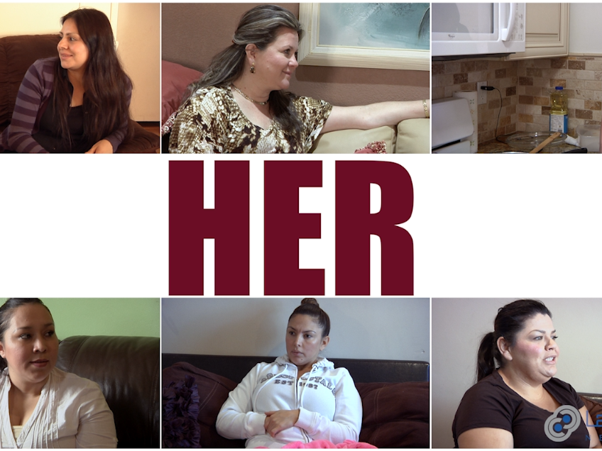
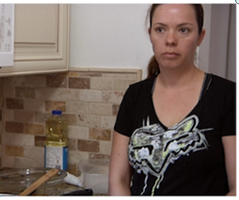
Her: Immersed With the Mobile Latina

Slide 35







Three Parts of Mom’s “Digital Mind”
1. Provide access to value
2. Save time
3. Be an emancipator
1. Connect to Culture
4. Be safe, not complicated
2. Education / Distraction
5. Get around the gate
3. Family Communication
1. Offer a mental break
2. Secure your spot in app real estate
3. Target the self-promoters

Slide 36

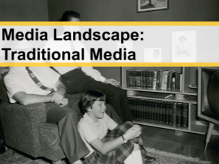
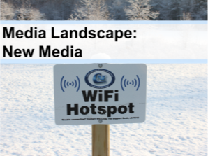
In Conclusion
U.S. Hispanics seek…
Cultural content
across traditional…
…and new media

